Slide 1

Topic 8
Loops

Slide 2
Loops

Slide 3
1
2
3
4
5
6
7
8
9
public class Loop5{
public static void main(String[] args){
System.out.println(1);
System.out.println(2);
System.out.println(3);
System.out.println(4);
System.out.println(5);
}
}
Design a program that prints the numbers from 1 to 5
1
2
3
4
5
6
7
8
9
10
11
12
13
14
public class Loop10{
public static void main(String[] args){
System.out.println(1);
System.out.println(2);
System.out.println(3);
System.out.println(4);
System.out.println(5);
System.out.println(6);
System.out.println(7);
System.out.println(8);
System.out.println(9);
System.out.println(10);
}
}
Design a program that prints the numbers from 1 to 10

Slide 4
1
2
3
4
5
6
7
8
9
public class Loop5{
public static void main(String[] args){
System.out.println(1);
System.out.println(2);
System.out.println(3);
System.out.println(4);
System.out.println(5);
}
}
1
2
3
4
5
6
7
8
9
10
11
12
13
14
public class Loop10{
public static void main(String[] args){
System.out.println(1);
System.out.println(2);
System.out.println(3);
System.out.println(4);
System.out.println(5);
System.out.println(6);
System.out.println(7);
System.out.println(8);
System.out.println(9);
System.out.println(10);
}
}
Now one that prints the numbers from 1 to 100
public class Loop5{
public static void main(String[] args){
System.out.println(1);
System.out.println(2);
System.out.println(3);
System.out.println(4);
System.out.println(5);
System.out.println(6);
System.out.println(7);
System.out.println(8);
System.out.println(9);
System.out.println(10);
System.out.println(11);
System.out.println(12);
System.out.println(13);
System.out.println(14);
System.out.println(15);
System.out.println(16);
System.out.println(17);
System.out.println(18);
System.out.println(19);
System.out.println(20);
System.out.println(21);
System.out.println(22);
System.out.println(23);
System.out.println(24);
System.out.println(25);
System.out.println(26);
System.out.println(27);
}
}

Slide 5

1
2
3
4
5
6
7
8
9
10
11
12
13
14
public class Loop10{
public static void main(String[] args){
System.out.println(1);
System.out.println(2);
System.out.println(3);
System.out.println(4);
System.out.println(5);
System.out.println(6);
System.out.println(7);
System.out.println(8);
System.out.println(9);
System.out.println(10);
}
}
1
2
3
4
5
6
7
8
9
public class Loop5{
public static void main(String[] args){
System.out.println(1);
System.out.println(2);
System.out.println(3);
System.out.println(4);
System.out.println(5);
}
}
public class Loop100{
public static void main(String[] args){
System.out.println(1);
System.out.println(2);
System.out.println(3);
System.out.println(4);
System.out.println(5);
System.out.println(6);
System.out.println(7);
System.out.println(8);
System.out.println(9);
System.out.println(10);
System.out.println(11);
System.out.println(12);
System.out.println(13);
System.out.println(14);
System.out.println(15);
System.out.println(16);
System.out.println(17);
System.out.println(18);
System.out.println(19);
System.out.println(20);
System.out.println(21);
System.out.println(22);
System.out.println(23);
System.out.println(24);
System.out.println(25);
System.out.println(26);
System.out.println(27);
}
}
Now one that prints the numbers from 1 to 100

Slide 6
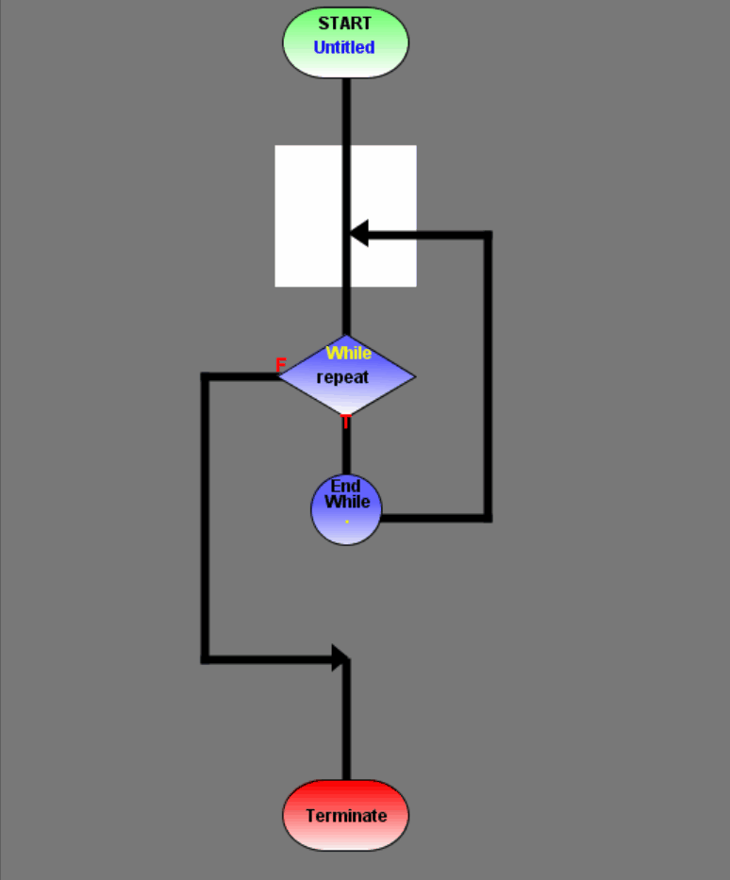

Computers are great at repeating instructions!

Slide 7
Loops
A block of instructions that will repeat based on a boolean expression.
Loop body: Code to be repeated
Control variable: Variable that will control
Exit condition: When will the block of code stop repeating?

Slide 8
While loops

Slide 9
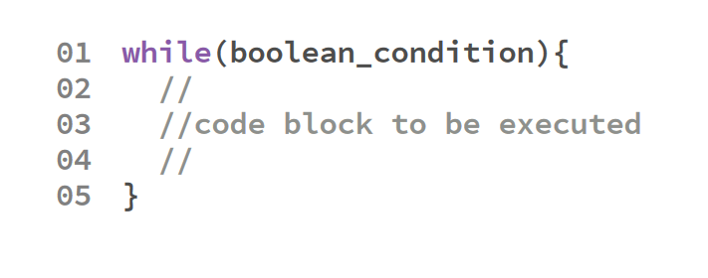
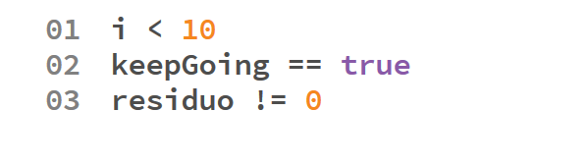
Sintaxis
Examples of boolean conditions
Conditions are boolean expressions

Slide 10
public class LoopTest {
public static void main(String[] args) {
int bits = 1;
int maxValues = 1;
while(bits <= 8) {
maxValues *= 2;
System.out.println(bits + " bit(s) -> " + maxValues + " values.");
bits++;
}
}
}

Slide 11
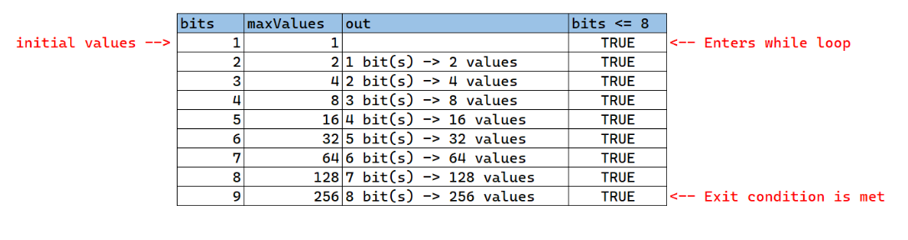
Code trace

Slide 12
Do-while

Slide 13
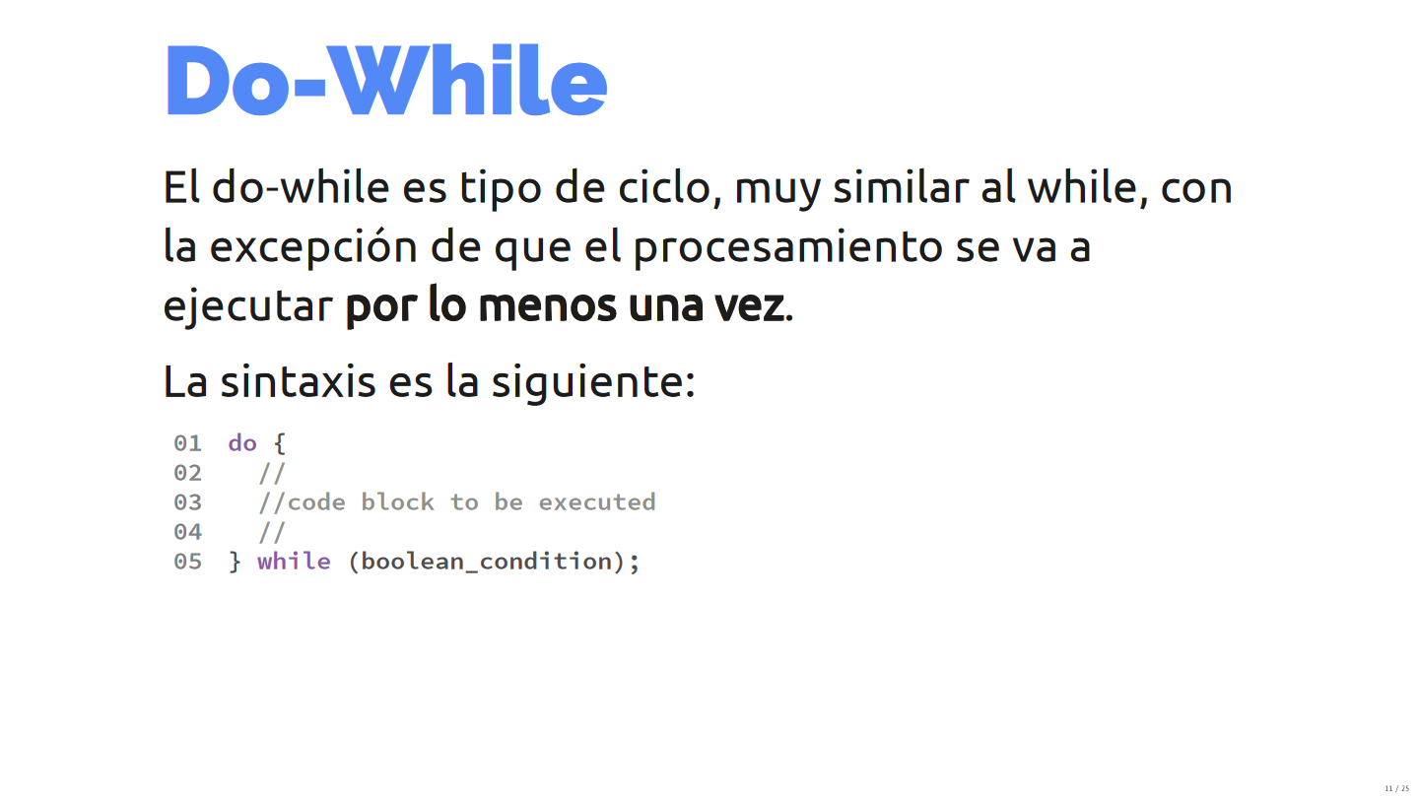

Slide 14
Do-whiles are very similar to whiles, with the exception that it will always be executed at least once.
This is because the Boolean condition is evaluated at the end of the loop, instead of at the start. This loops are very useful when validating inputs from the keyboard.

Slide 15
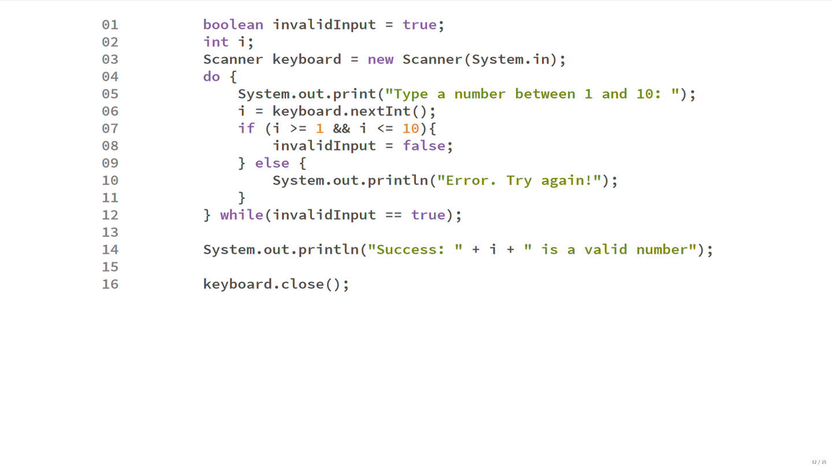

Slide 16
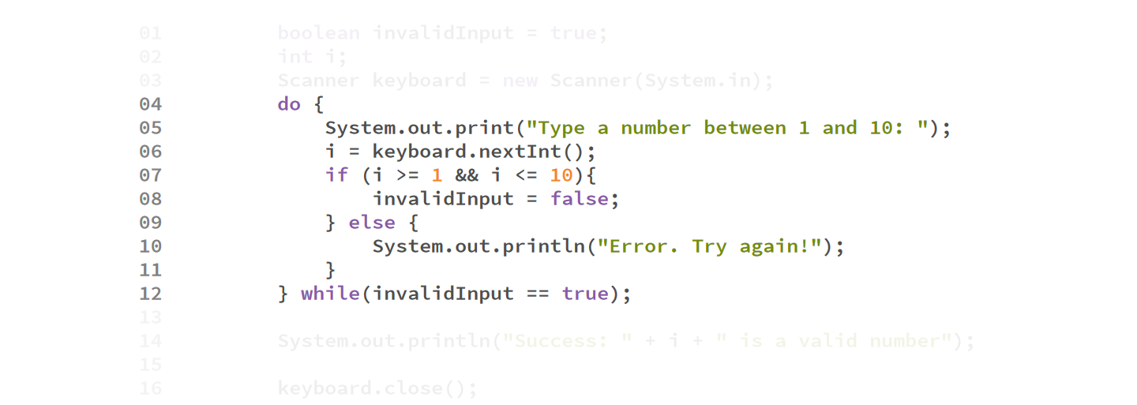

Slide 17
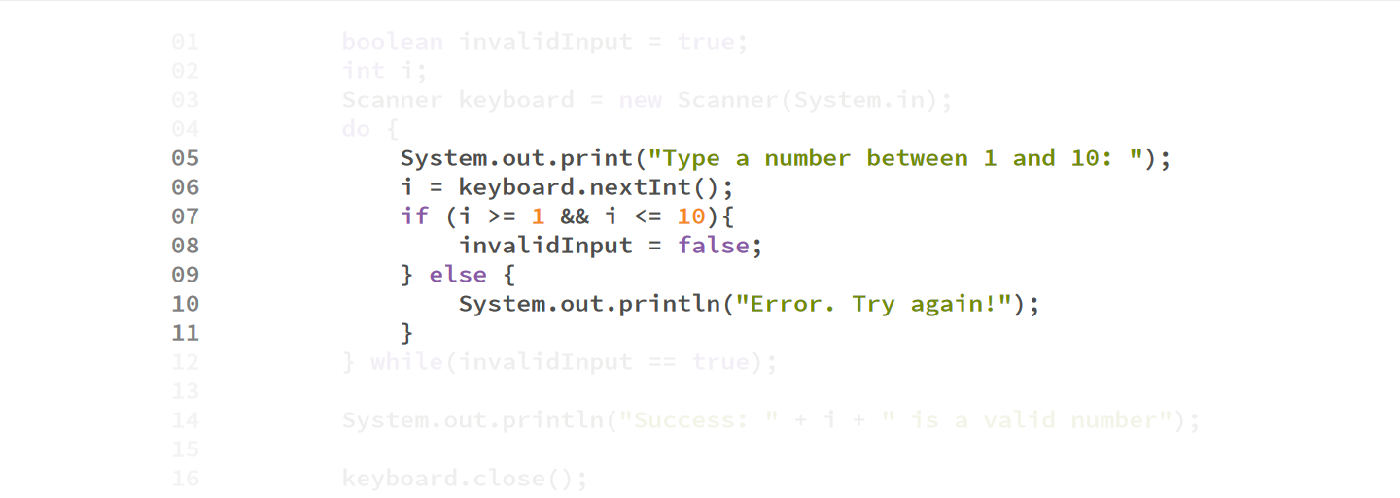

Slide 18
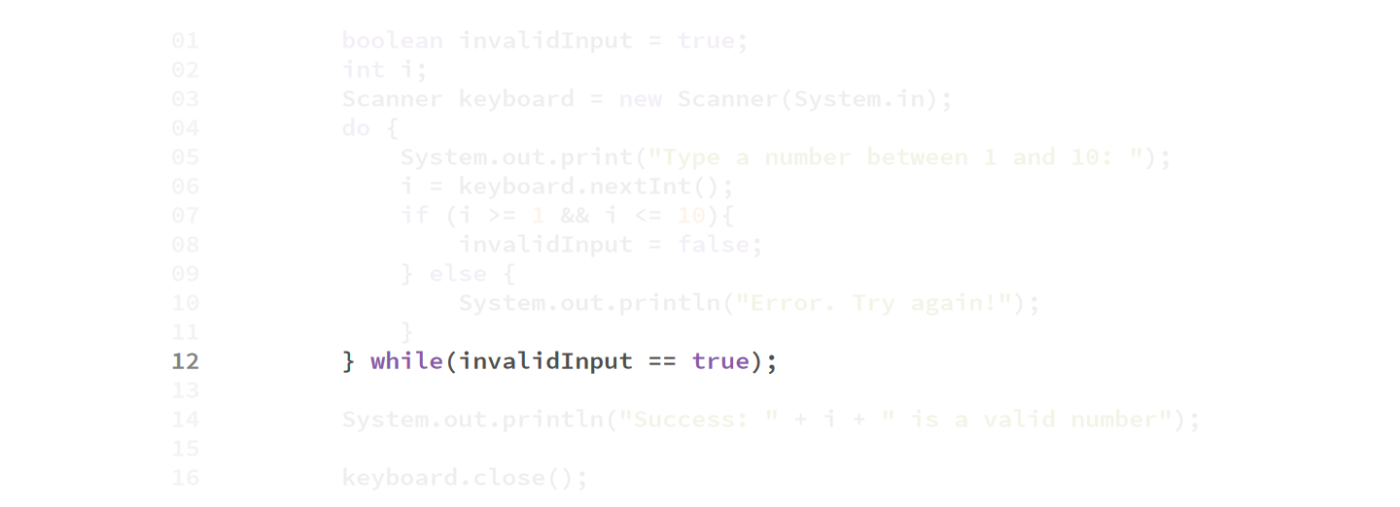

Slide 19
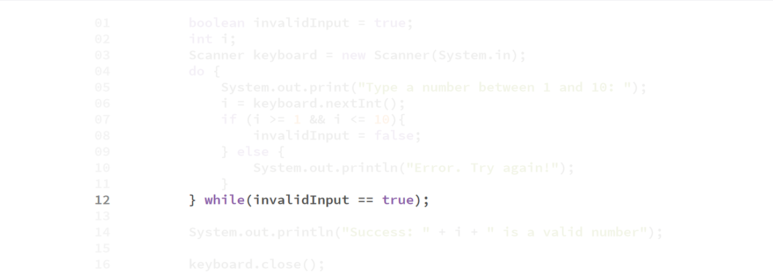

Slide 20
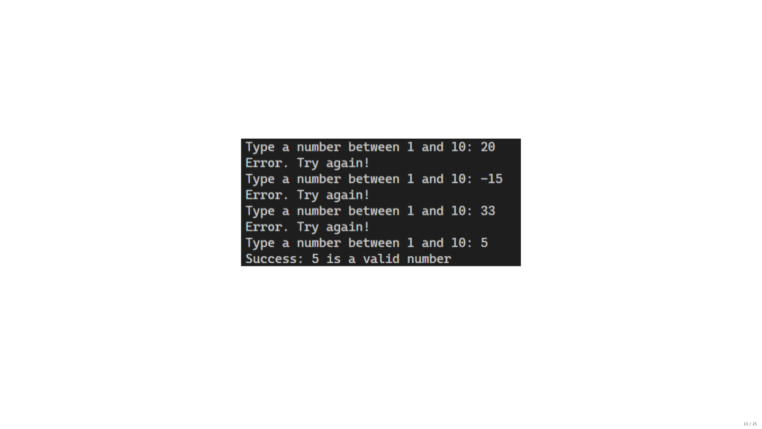

Slide 21
For loop

Slide 22
For loops
For-loops are generally used to repeat a set of instructions a set number of times.
The syntax is as follows:
for(initialization; condition; update) {
//body of loop to be repeated
}

Slide 23
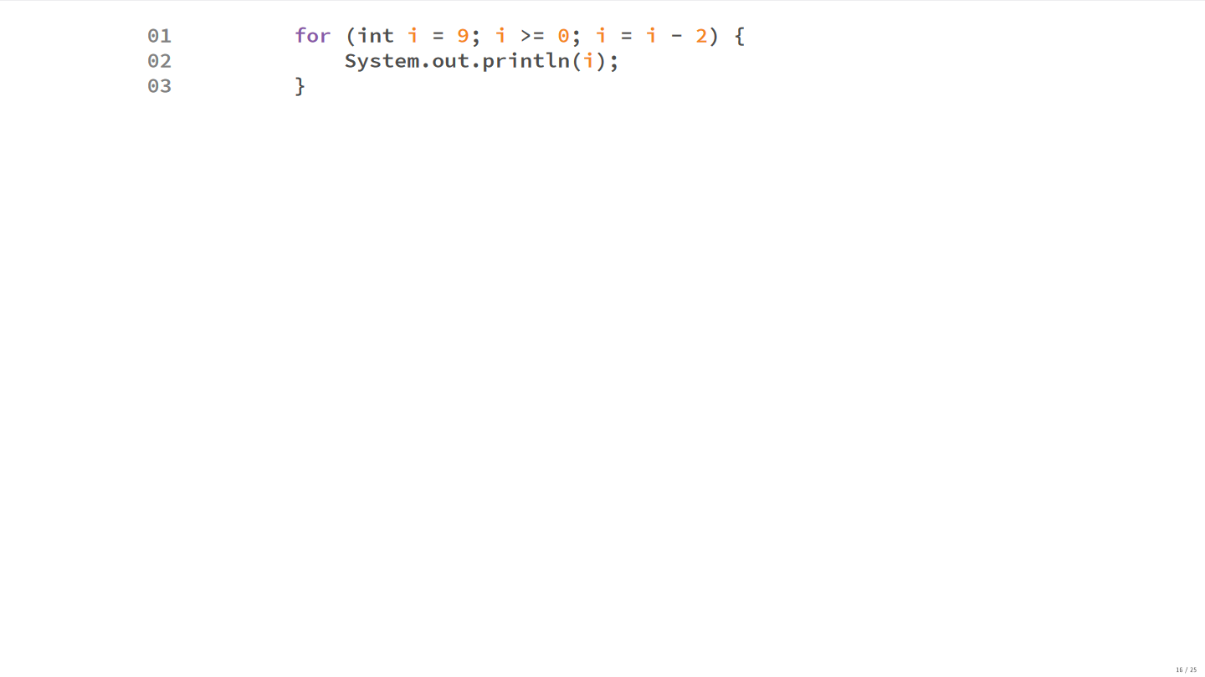

Slide 24
Example

Slide 25
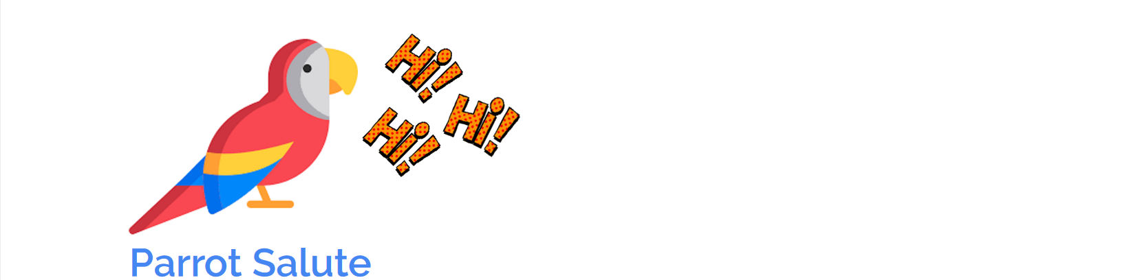
In the Monterrey zoo, there is a very well-educated parrot that salutes everyone that passes by.
Build a program that reads the group size from the keyboard, and then print a salute for every persons in the group.
Consider that groups need to be between 0 and 10 in size.

Slide 26
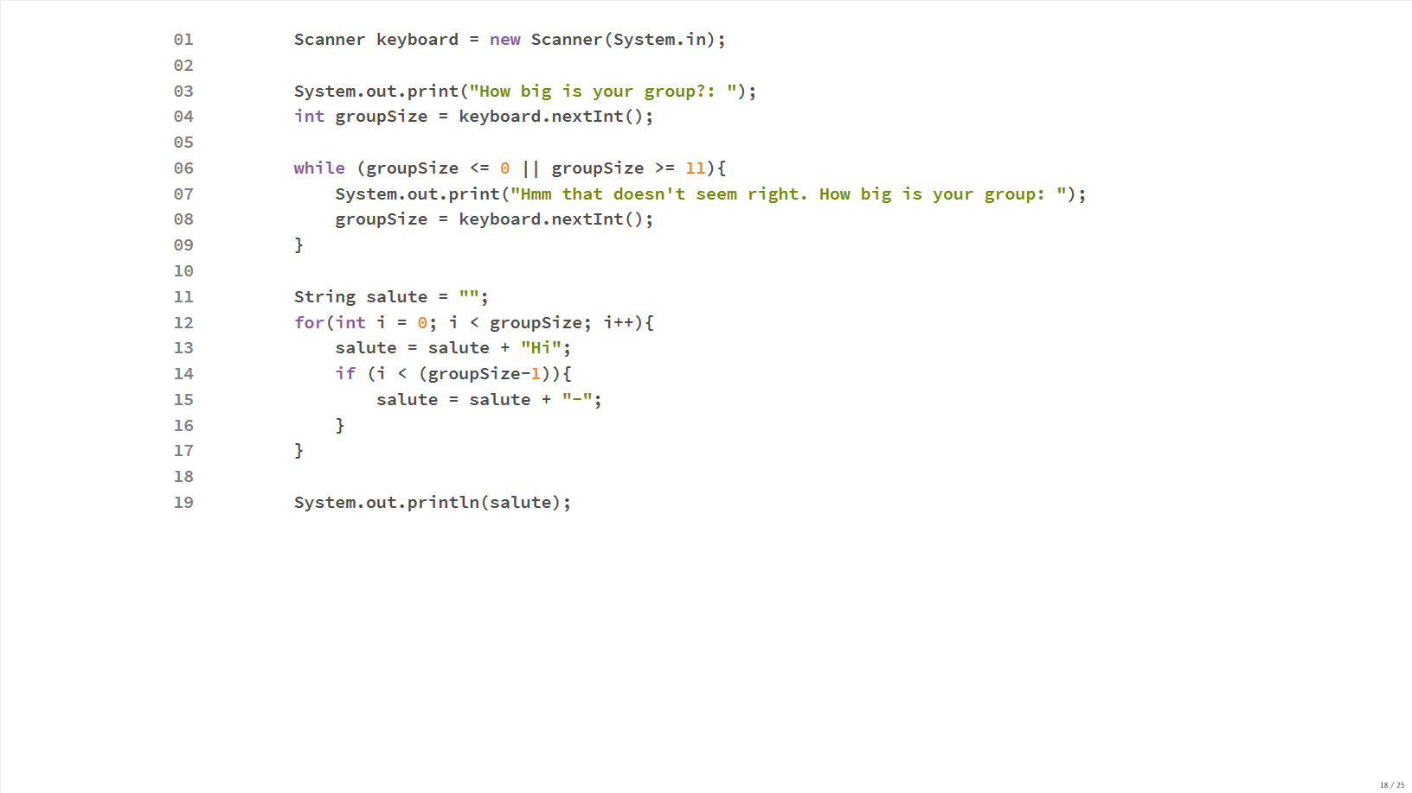

Slide 27
Common problems

Slide 28
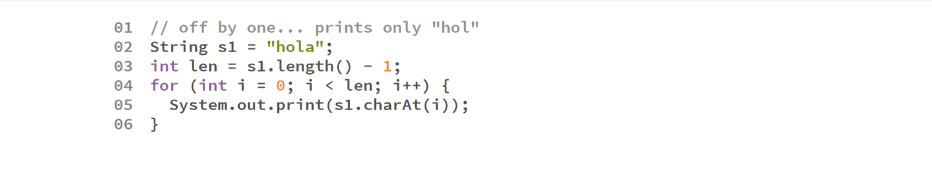
Common loop problems
Off by one: The program loops fewer times than expected, or more times than expected.

Slide 29
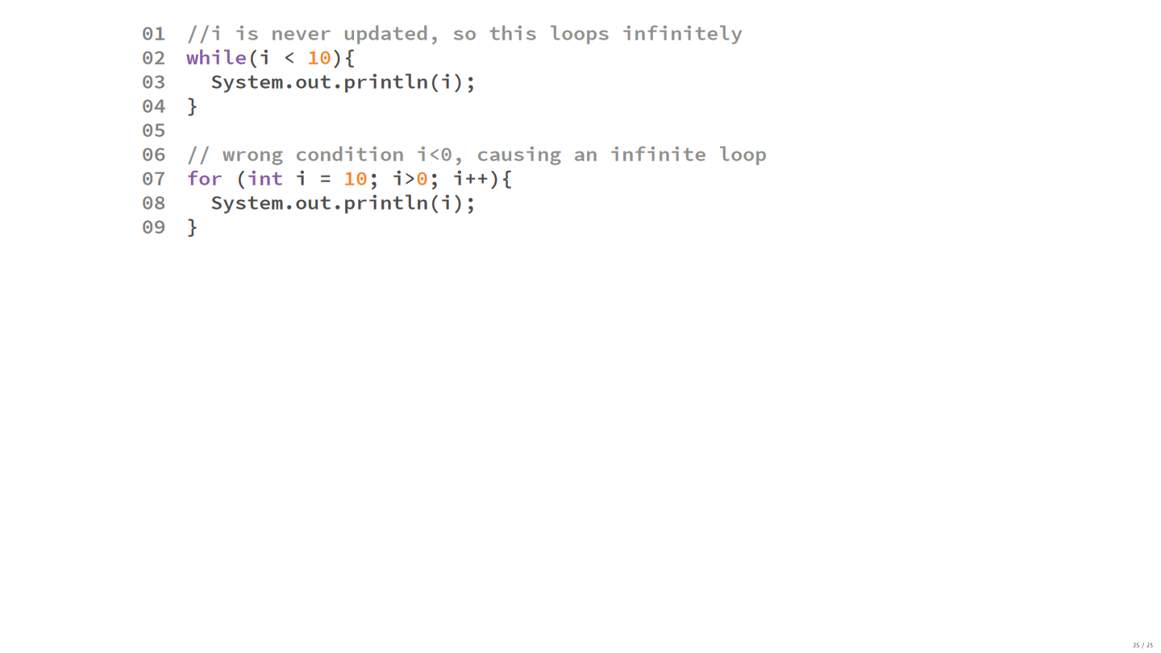
Common loop problems
2. Infinite loops: Under certain conditions, the loop will never end

Slide 30
Common loop problems
3. Wrong boolean expressions: The loop is never entered or never exited

